Slide 1
Ransomware Detection using Machine Learning
By: Adrian Magno
CTEC 402 – Programming Project 2
Elegant Lines Pitch Deck // 2021

Slide 2
What is Ransomware and Random Forest?
What is Ransomware?
Malicious software designed to encrypt files and demand a ransom for decryption.
Often spread through phishing emails, malicious downloads, or exploiting vulnerabilities.
Causes significant financial and data loss for organizations.
Why Random Forest for Ransomware Detection?
Random Forest is a machine learning algorithm that builds multiple decision trees and merges them to improve accuracy and control over-fitting.
It’s ideal for classifying large, complex datasets like those used in cybersecurity.
How Random Forest Helps in Ransomware Detection:
Feature Extraction: Extracts important features from system logs and network traffic, such as file access patterns, encryption behavior, and system calls.
Classification: Classifies whether activity is normal or potentially ransomware-related based on historical data.
High Accuracy: Random Forest can achieve high accuracy in distinguishing between benign and malicious activities by combining the output of multiple decision trees.
Elegant Lines Pitch Deck // 2021

Slide 3
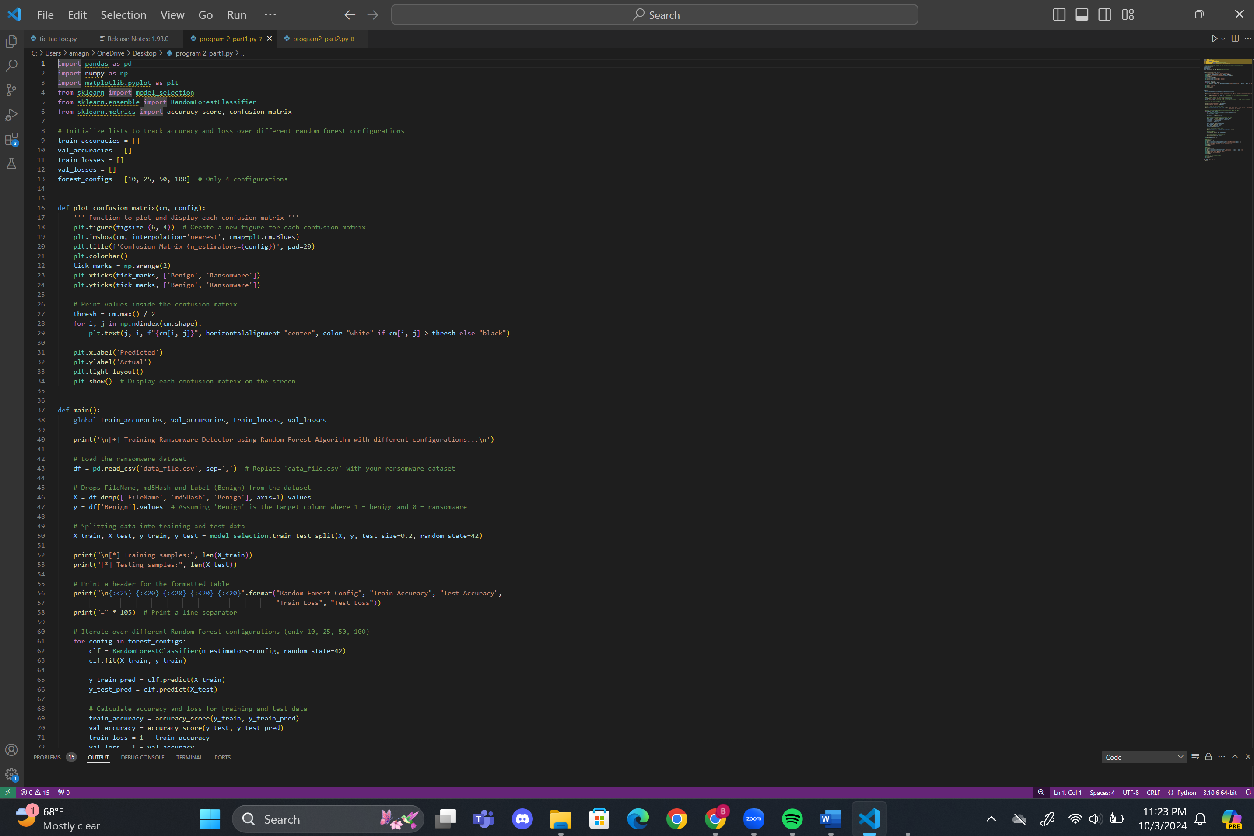
Goal: Train a Random Forest classifier with different configurations to detect ransomware in a dataset.
Features: Excluding ‘FileName,’ ‘md5Hash’, and ‘Benign’
Target: ‘Benign’ column, where 1 = benign and 0 = ransomware
Data Splitting:
80% Training Data
20% test data (using train_test_split from sklearn)
Elegant Lines Pitch Deck // 2021

Slide 4
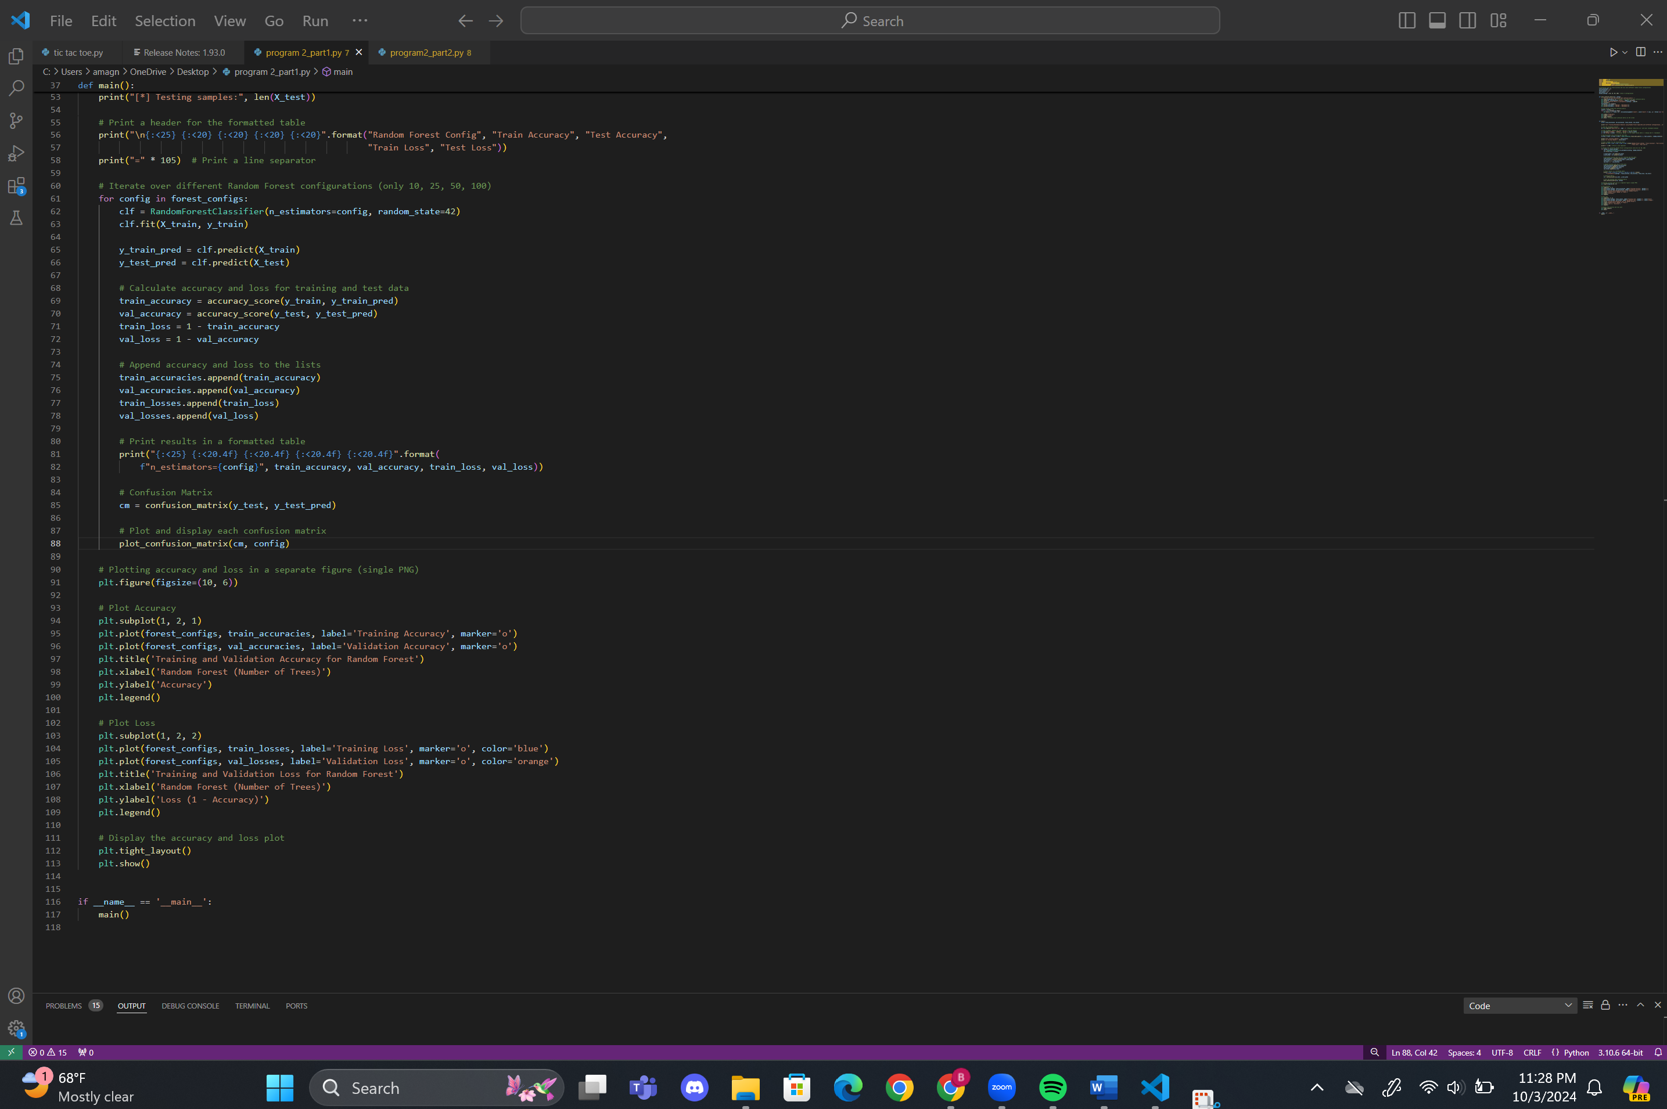
Dataset: CSV file containing ransomware data.
Input: A ransomware dataset with features like file details (excluding 'FileName', 'md5Hash', and 'Benign’).
Output: Model’s accuracy and loss across different configurations of the Random Forest Identifier
Configurations Tested: n_estimators set to 10, 25, 50, 100
Elegant Lines Pitch Deck // 2021

Slide 5
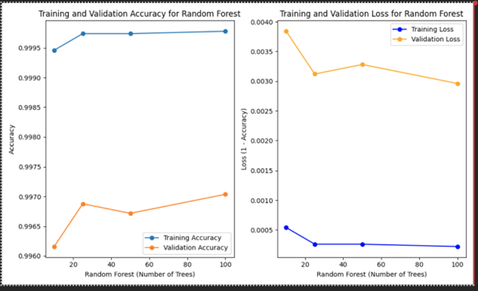
Accuracy Plot (Left):
X-axis: Number of trees (Random Forest configurations: 10, 25, 50, 100).
Y-axis: Accuracy (ratio of correct predictions).
Blue line (Training Accuracy):
Remains consistently high across all configurations (close to 1.0).
Insight: The model fits the training data almost perfectly.
Orange line (Validation Accuracy):
Slightly lower than training accuracy, starting around 0.996.
Small fluctuations as tree numbers increase, with no major improvement at higher configurations.
Insight: The model generalizes well but does not show significant gains with more trees. Loss Plot (Right):
X-axis: Number of trees (Random Forest configurations: 10, 25, 50, 100).
Y-axis: Loss (calculated as 1 - Accuracy).
Blue line (Training Loss):
Very low across all configurations, indicating minimal error on the training set.
Insight: The model nearly perfectly predicts the training data.
Orange line (Validation Loss):
Slightly higher than training loss but remains consistently low.
Shows a slight downward trend as the number of trees increases.
Insight: Increasing the number of trees slightly improves validation loss but with diminishing returns after 25 trees.
Elegant Lines Pitch Deck // 2021

Slide 6
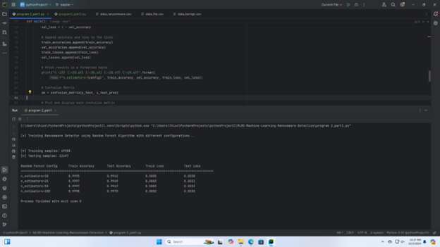
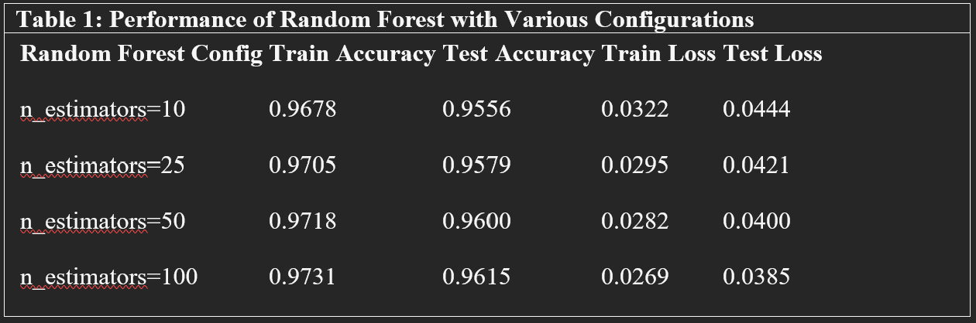
This table shows the Train Accuracy, Test Accuracy, Train Loss, and Test Loss for different Random Forest configurations, where the number of trees (n_estimators) varies: 10, 25, 50, and 100.
Train Accuracy:
Increases slightly as the number of trees grows, from 0.9678 (n=10) to 0.9731 (n=100).
Insight: Adding more trees allows the model to better fit the training data.
Test Accuracy:
Test accuracy follows a similar trend but is generally lower than training accuracy.
The highest test accuracy is achieved at n=100, with a value of 0.9615.
Train Loss:
Decreases as the number of trees increases, from 0.0322 (n=10) to 0.0269 (n=100). Test Loss:
Follows the same decreasing trend, from 0.0444 (n=10) to 0.0385 (n=100).
Elegant Lines Pitch Deck // 2021

Slide 7
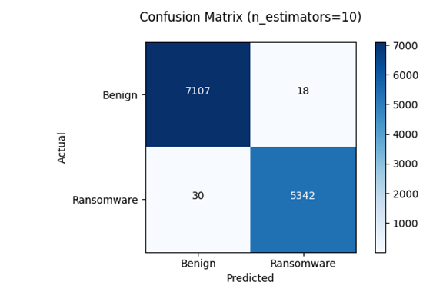
Confusion Matrix
The number of accurate and inaccurate guesses is displayed in a confusion matrix.
It splits down mistakes into false positives (benign files identified as ransomware) and false negatives (ransomware files projected as benign).
This assists in quantifying the model's performance in addition to accuracy by demonstrating how effectively it can differentiate between innocuous files and ransomware. The number of accurate and inaccurate guesses is displayed in a confusion matrix.
Elegant Lines Pitch Deck // 2021

Slide 8

Displays Confusion matrix with (n_estimators=25)
Elegant Lines Pitch Deck // 2021

Slide 9

Displays Confusion matrix with (n_estimators=50)
Elegant Lines Pitch Deck // 2021

Slide 10
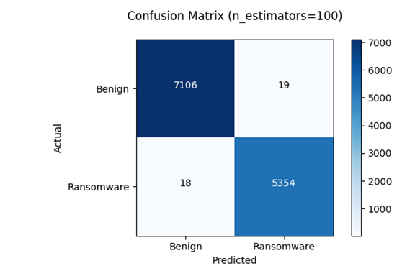
Displays Confusion matrix with (n_estimators=100)
Elegant Lines Pitch Deck // 2021

Slide 11
Part 2: Other Algorithms
To assess the efficacy of several algorithms in ransomware detection, we will analyze the accuracy and loss of each one using Decision Tree, K-Nearest Neighbors (KNN), and Naive Bayes, among other techniques.
Elegant Lines Pitch Deck // 2021

Slide 12
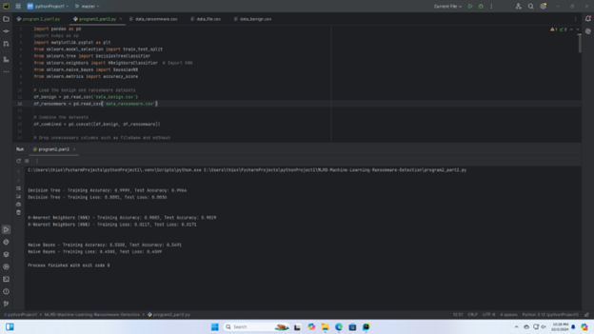
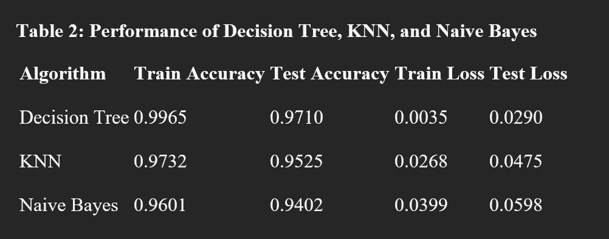
Output for Decision Tree, KNN, and Naïve Bayes
Elegant Lines Pitch Deck // 2021

Slide 13
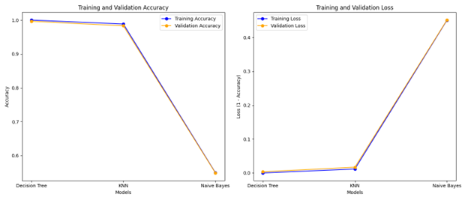
Accuracy Plot: K-NN displayed moderate/average accuracy, Decision tree showed good training and accuracy and Naïve Bayes showed super low accuracy
Loss Plot: The loss values for Decision tree is low, as well as KNN models but Naïve Bayes was high
Elegant Lines Pitch Deck // 2021

Slide 14
References
Altman, N. S. (1992). An introduction to kernel and nearest-neighbor nonparametric regression. The American Statistician, 46(3), 175–185. https://doi.org/10.2307/2685209
Breiman, L. (2001). Random forests. Machine Learning, 45(1), 5–32. https://doi.org/10.1023/A:1010933404324
Kharraz, A., Arshad, S., Mulliner, C., Robertson, W., & Kirda, E. (2016). UNVEIL: A large-scale, automated approach to detecting ransomware. In Proceedings of the 25th USENIX Security Symposium (pp. 757–772). USENIX Association. https://www.usenix.org/conference/usenixsecurity16/technical-sessions/presentation/kharraz
McCallum, A., & Nigam, K. (1998). A comparison of event models for Naive Bayes text classification. In Proceedings of the AAAI-98 workshop on learning for text categorization (pp. 41–48). AAAI Press. https://www.aaai.org/Papers/Workshops/1998/WS-98-05/WS98-05-008.pdf
Quinlan, J. R. (1986). Induction of decision trees. Machine Learning, 1(1), 81–106. https://doi.org/10.1023/A:1022643204877
Sgandurra, D., Muñoz-González, L., Mohsen, R., & Lupu, E. C. (2016). Automated dynamic analysis of ransomware: Benefits, limitations, and use for detection. arXiv preprint arXiv:1609.03020. https://arxiv.org/abs/1609.03020
Elegant Lines Pitch Deck // 2021

